Slide 1
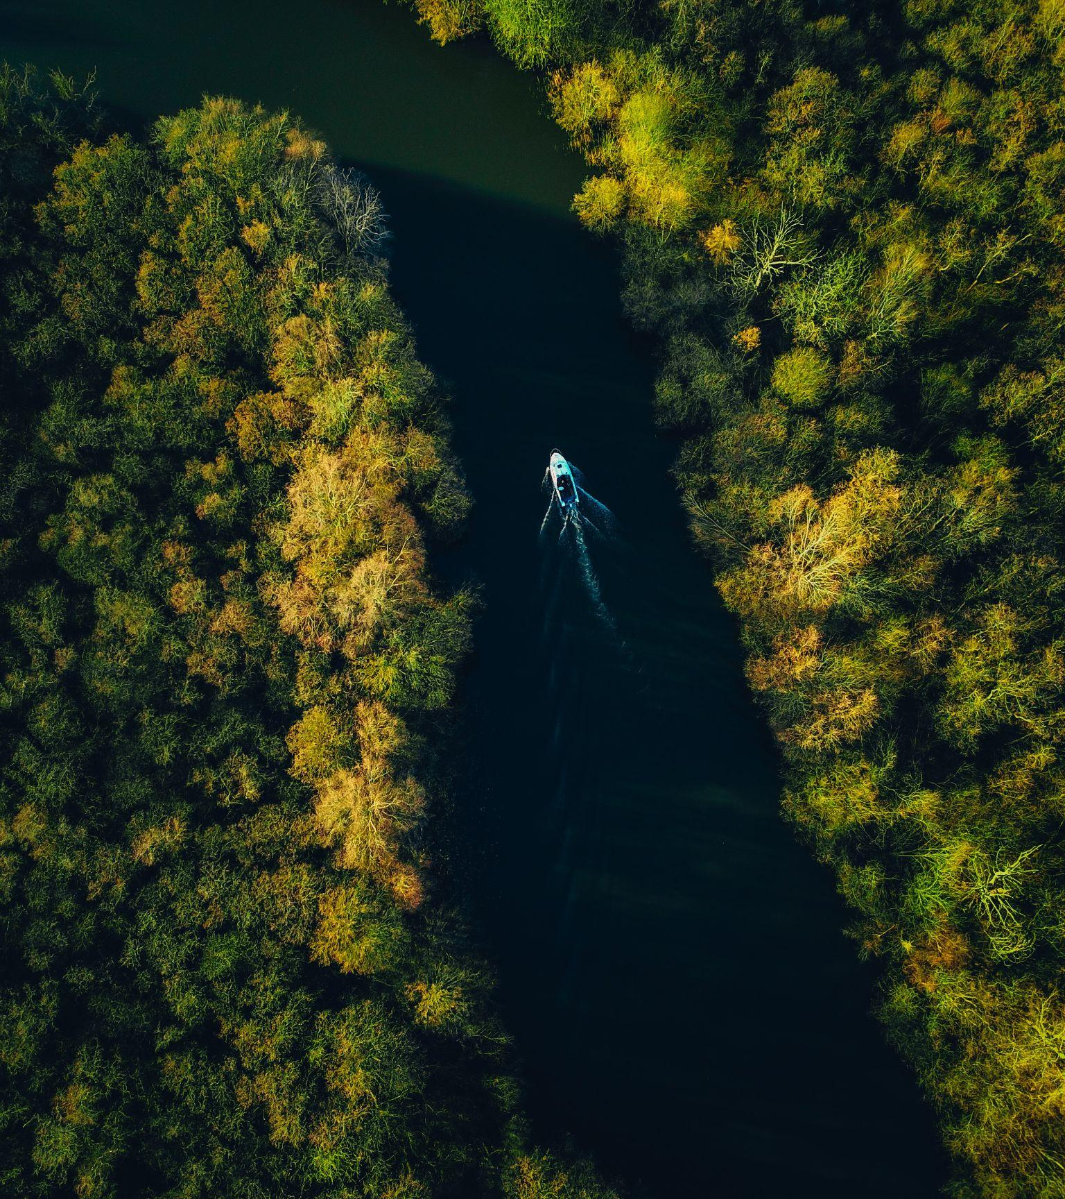
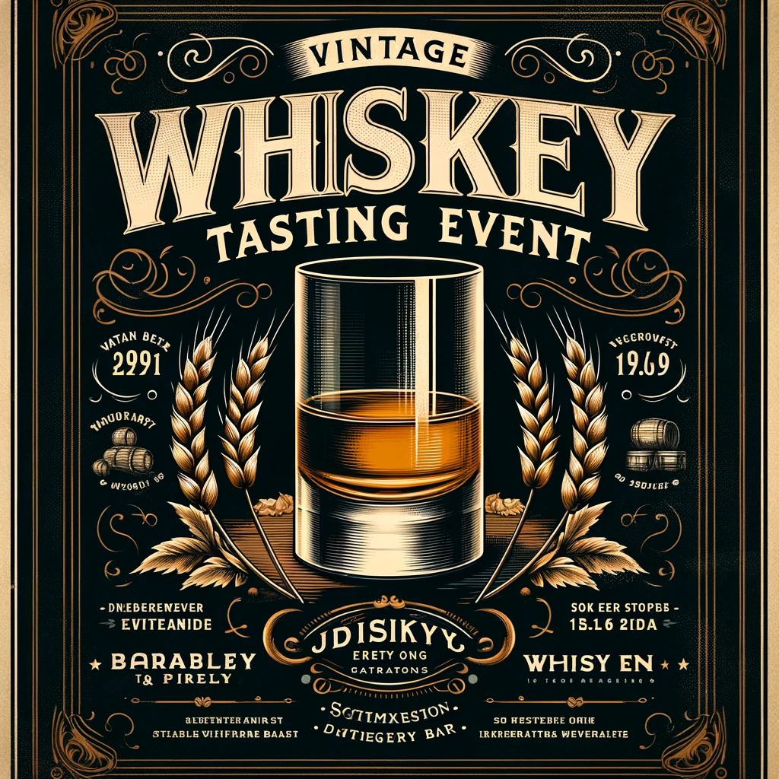
Wee Social Whiskey Tasting with Mr McKale
By Anthony McKale Associate Director of DevOps and Cloud
Date 03-2024

Slide 2
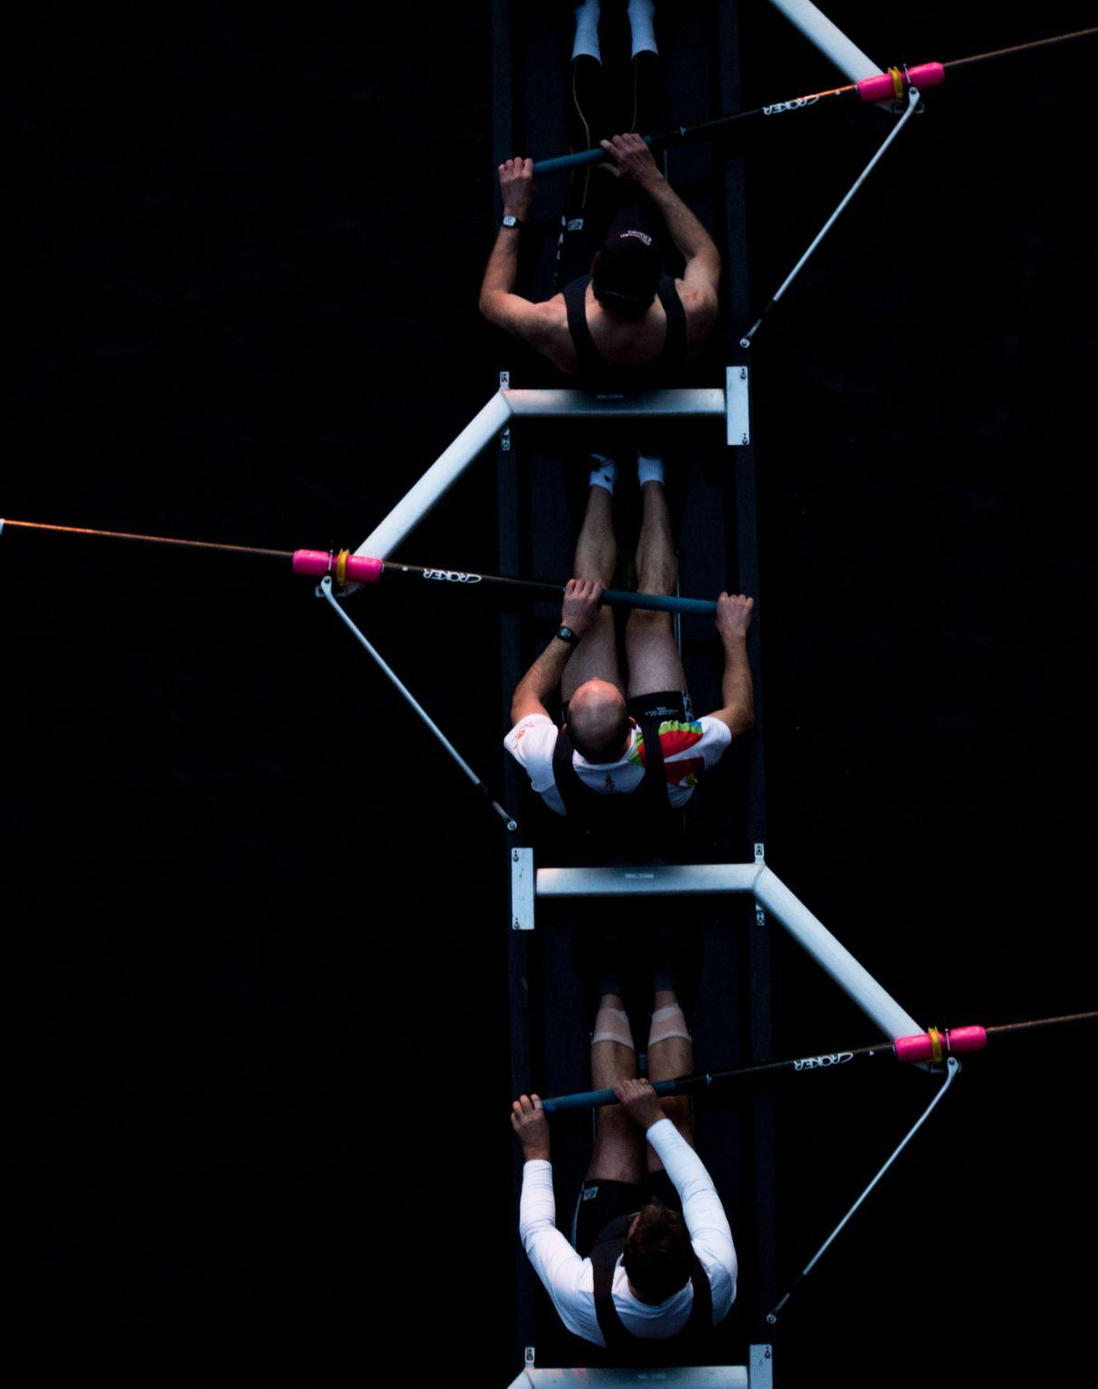
Disclaimer This talk is based off many previous talks, done at many previous times and place, over many many years THIS TALK IS MIT LICENSED

Slide 3
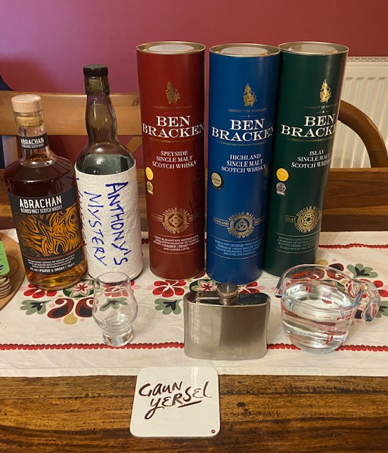
TABLE OF CONTENTS 5PM - 6PM: Whiskey Tasting - INTRO TO WHISKEY + 101 - WHISKEY TASTING NOTES
- DRINK + CHAT 6PM: Competition
- GUESS THE MYSTERY WHISKEY COMPETITION WIN IRU-BRU

Slide 4
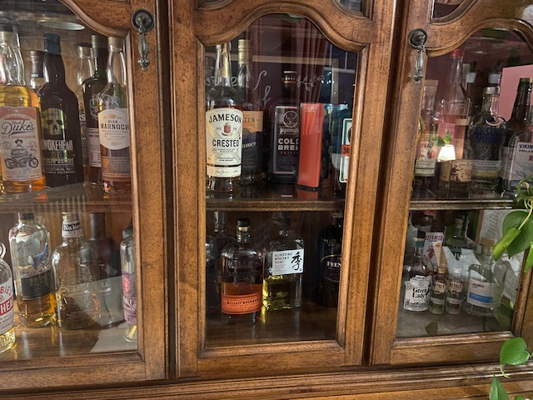
Intro to WHISKEY

Slide 5
INTRO
14 Whiskies to Taste 1 Whiskey to identify
Covering Highland, Islay, Speyside, Blended and lastly Non-Alcoholic

Slide 6
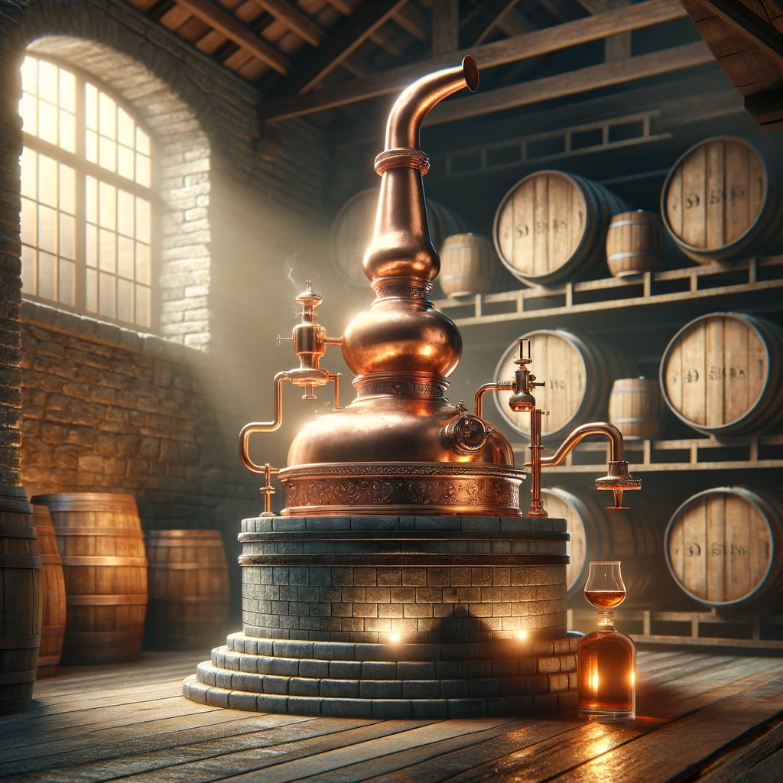
WHISKEY 101
Ireland did it first * Scotland’s whiskey before 19th century best described rot gut, professionalised during highland clearances
Scotland copied it in 19th century
Whiskey is Fractional Distilled Barley Wine aged in Oak Barrels* * Oak barrels happy accident of American coopers unionisation

Slide 7
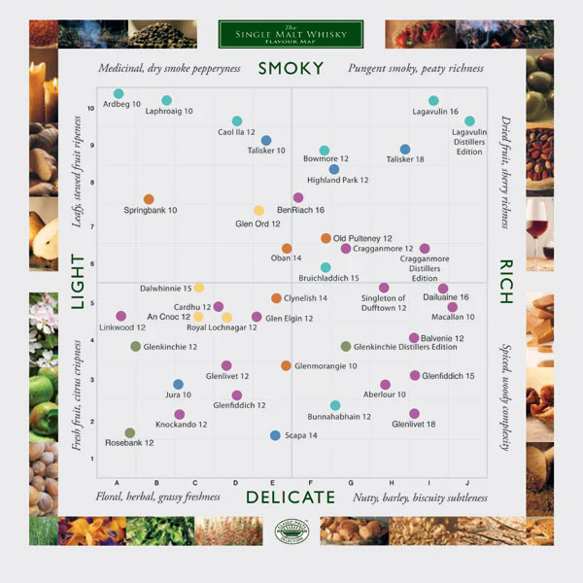
WHISKEY FLAVOURS
Smoky * from Western Isles Peat (soil) (Islay / Harris famous for this)
Rich Fruity, almost Earthy Jam * Similar to Sherry, from Oak Barrels
Delicate Floral Smells * From Alcohol byproducts, ironical top/tail is delicious but basically antifreeze, why Whiskey/Spirits high regulated
Light apple and lemon * Normally in the first taste, then quickly dominated by the above flavours

Slide 8
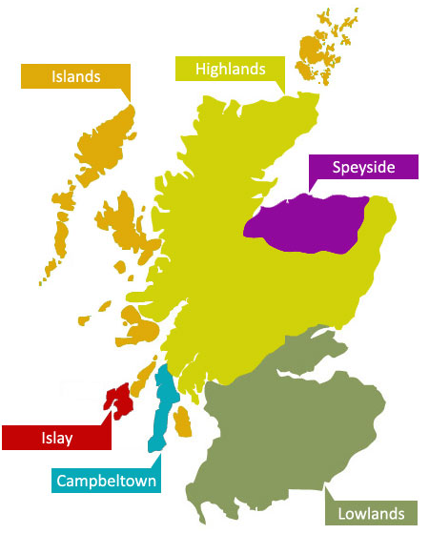
WHISKEY TODAY
Highlands expect Deep fruity complexity, think liquid mince pies or Christmas cake
Speyside expect Rich Fruit, Oak, and Floral complexity
Islay expect Smokiness, lots and lots of torf
Blends - Combinations of several distilleries expect the unexpected, often under-rated

Slide 9
Whiskey Tasting Notes
From a opinionated Scotsman

Slide 10
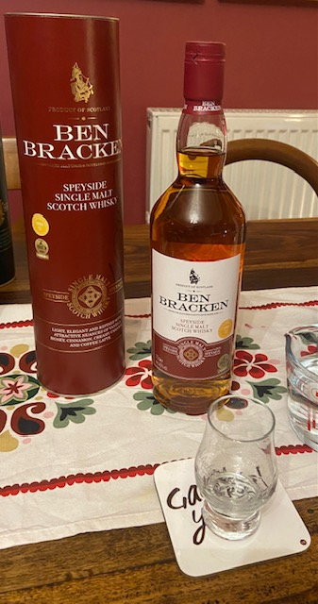
‘Speyside’ Ben Bracken
Colour: Honey Amber Nose: Dark Cherry Palate: Strong rich fruits, demerara sugar
Finish:
Vanilla honey, creamy caramel coffee latte, and maple syrup

Slide 11
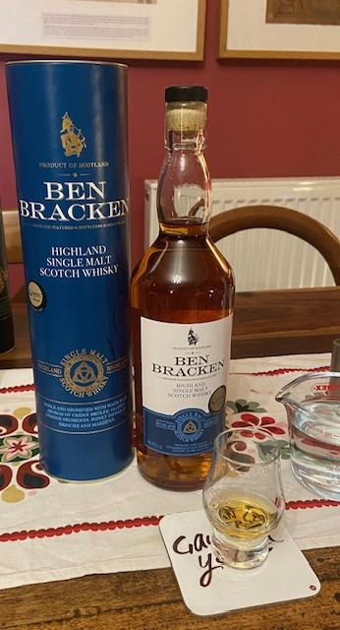
‘Highland’ Ben Bracken
Colour: Dark Honey Amber Nose: Faint Light Burnt Sugar Palate: Sugar Water, Light, Slight Cola Hints
Finish:
Complex dark fruits, Hard Vanilla Extract, with Sweet Oak coming at the end

Slide 12
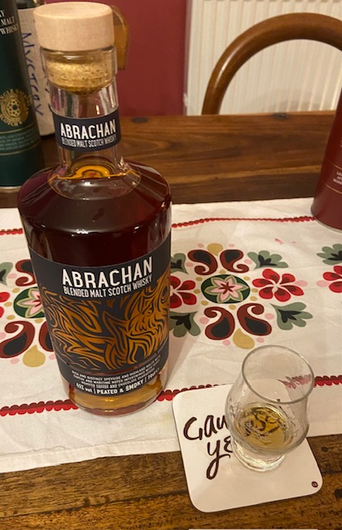
‘Blend’ Abrachan
Colour: Cola Brown Nose: Light Fruity sugar Palate: Strong caramel with a peppery edge
Finish:
Sherry, grain sweetness, light vanilla/menthol edge (peppermint?)

Slide 13
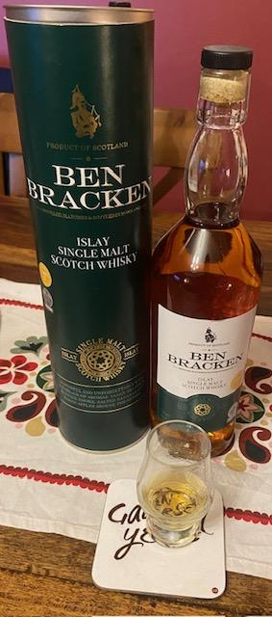
‘Islay’ Ben Bracken
Colour: Ale Amber Brown Nose: Smoky Smouldering Fireplace Palate: Cigar, peppercorn, maple syrup
Finish:
Spicy soot (horse-radish?), dark fruit, orange peel

Slide 14
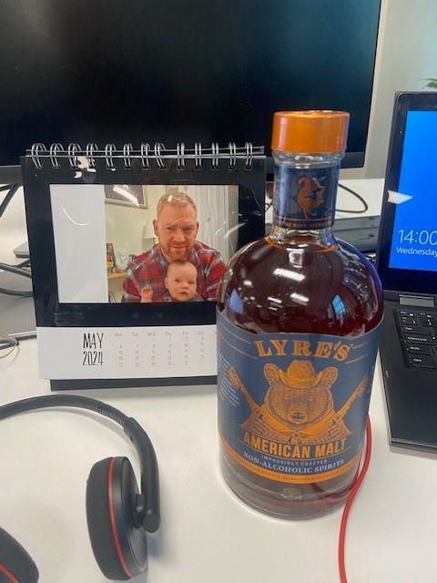
Lyre’s American Malt
Colour: Dark Brown Nose: None Palate: Lightly spiced flavoured water
Finish:
Same, lightly chillied water

Slide 15
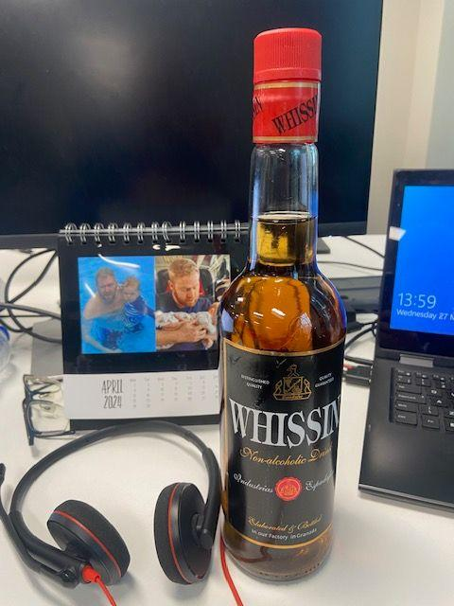
Whissin- Granada
Colour: Yellowy Brown Nose: Candied Sugar, Sweet, Golden Syrup Palate: Oh… nice, not whiskey but nice clean sweet sugary syrup, almost like a bourbon
Finish:
Slight complexity in finish, but overpoweringly violent candy taste

Slide 16
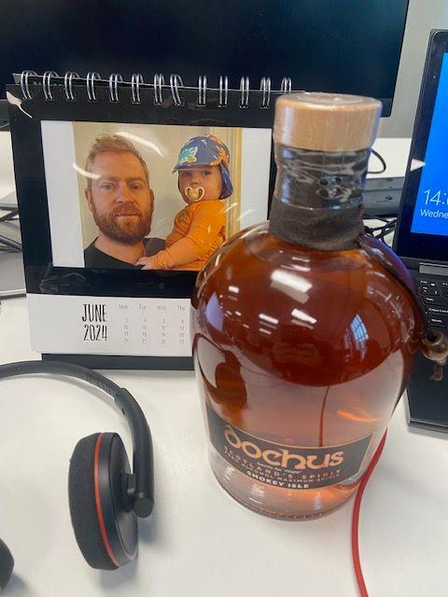
Dochus - smokey isle
Colour: Orangy Brown Nose: Actually smells like Whiskey, no smoke though Palate: Oh… chemicals, tobacco, vanilla, caramel, banana peel… weird… not terrible
Finish:
Paint stripper ? It’s not terrible, I’ve had worse cheap blended whiskey…

Slide 17
Chat and Talk Till 6PM

Slide 18

Surprise
Whiskey can be very expensive: Fools and their Money are easily parted
Good Whiskey shouldn’t cost more than £40 All whiskey today were own brand supermarket and under £20
Anything older than 12 years is likely a waste of money

Slide 19
Whiskey Competition 6pm - 6.30pm

Slide 20
Whiskey Competition
4 Voluteeners requested, various experience levels - Preferably one non-alcohol drinking (aka to detect via smell only) Guesses in order of whiskey experience

Slide 21
Whiskey Competition
1st of 2 Audience participation Question: ELIMINATOR: 1st) Which Region is my Whiskey from ? Options:
Islay
Speyside
Highland
Blend

Slide 22
Mystery Whiskey
Colour: Golden Orange Nose: Roaring Smoky Peat Fireplace Palate: Peaty Punch to the face, peppercorns stabbing your tongue
Finish:
Overpowering Wasabi spice, Fruity Mince-pie, Cigar aftertaste

Slide 23
Whiskey Competition
2nd of 2 Audience participation Question: SUDDEN DEATH ROUND: 2) Which Whiskey is the Mystery Whiskey ? Options:
Laphroaig
Ardbeg
Big Peat
Smoke Head

Slide 24
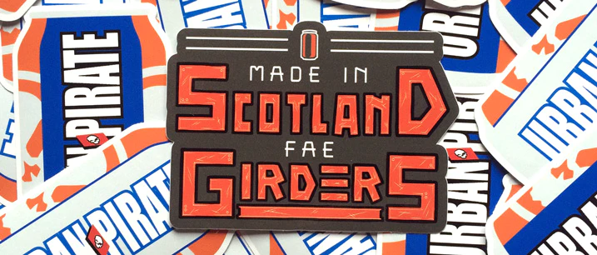
Whiskey Competition
CONGRATS YOU’VE WON A WEE BIT OF SCOTLAND

Slide 25

Questions?

Slide 26
Thank you for your Awesomeness
If you have any questions anthony.mckale@6point6.co.uk #dep-eng-devops (slack)

